Slide 1


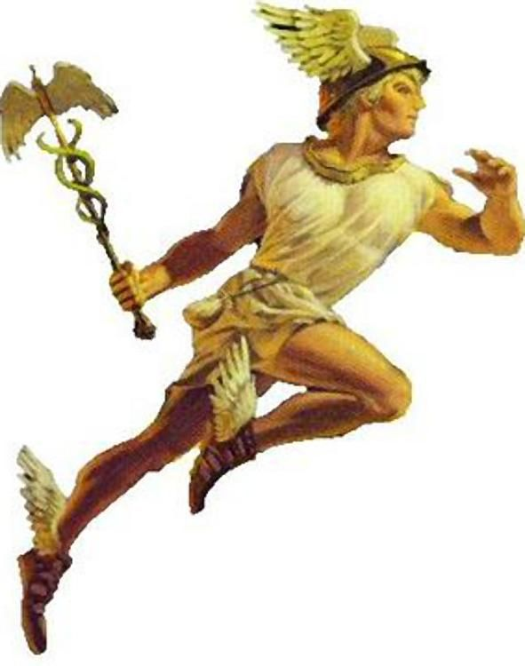







ETL model
Load
Generate
hermesql
Generate
Power BI
SQL
SQL
Excel
Data warehouse
ETL
tabint

Slide 2



Hermesql
ETL model
Power query {SQL}
Power BI
Excel
tabint
Datasources
Azure data lake
Dataset
Dataflows
Power BI service
Report and analytics

